Slide 1
Enterprise Architecture Patterns

Slide 2
Enterprise Architecture Patterns : Layering
Evolved from Monolithic to Distributed
Three Principal Layers
  Presentation
  Domain
    aka Business Logic
  Data Source
    Own Vs Other applications
What runs Where
Notes:
test

Slide 3
Enterprise Architecture Patterns : Layering
Brown Layers
  Presentation, Controller, Domain, Data mapping, Data source
Core J2EE
  Client, Presentation, Business, Integration, Resources
Microsoft DNA
  Presentation, Business, Data access
Marinescu Layers
  Presentation, Application, Services, Domain, Persistence
Nilsson Layers
  Consumer, Consumer helper, Application, Domain, Persistence access, Public stored procedures, Private stored procedures
Notes:
test

Slide 4
Enterprise Architecture Patterns : Domain Logic
How to organize business logic
The simplest pattern is Transaction Script
  Application is thought of a series of transaction
  Organizes all logic as procedures known as transaction scripts
    Each procedure handles a single request from presentation
    Each procedure makes call to database directly or through thin wrapper
  Each transaction has one and only one transaction script
    Common subtasks can be broken into sub procedures and called from two procedures
  Does not work well for complex business logics
Notes:
test

Slide 5
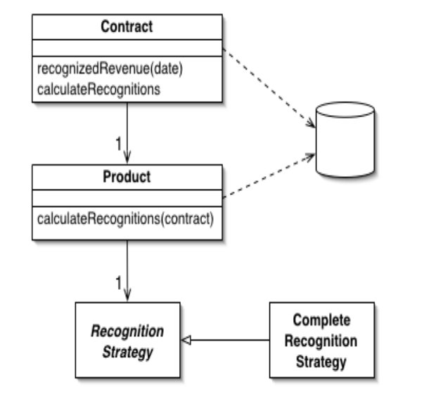
Enterprise Architecture Patterns : Domain Logic
Domain Model tries to address business logic complexity
Creates a Web of Interconnected Objects
  Objects can represent data, process or both
Simple Domain Model
  Most of the Objects map to database table
  There are rule objects also
Rich Domain Model
  Handles complex business logic
  Objects do not map to database directly
  Persistence is handled through persistence layer or similar
Notes:
test

Slide 6
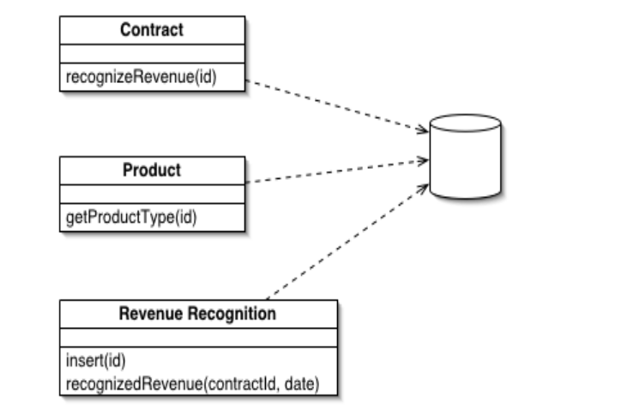
Enterprise Architecture Patterns : Domain Logic
Table Module tries to rely on traditional definition of Objects having identity and behaviour
Identity of each object maps to table(s) in data store
Behaviour handles the business logics
Notes:
test

Slide 7
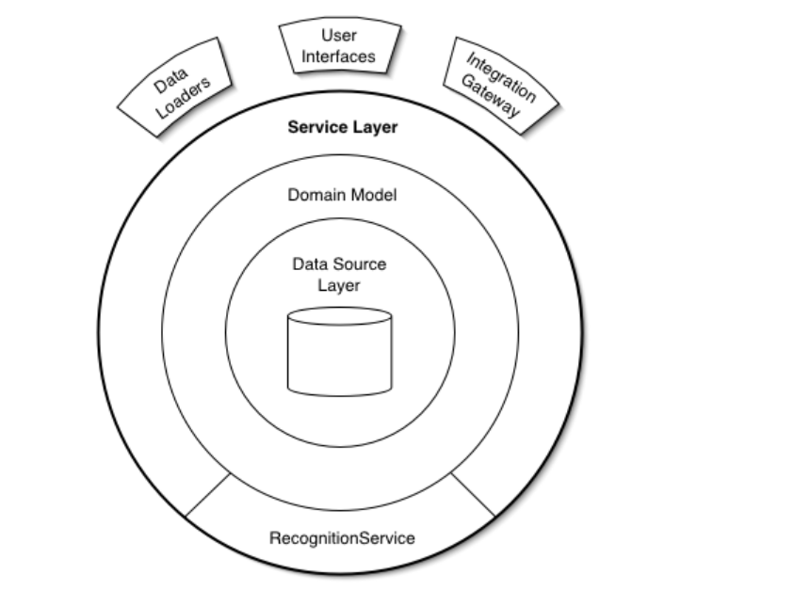
Enterprise Architecture Patterns : Domain Logic
Service Layer tries to map closely with real world
Defines boundary with a layer of services
Services expose operations and coordinates with different parts to implement the operations
Notes:
test

Slide 8
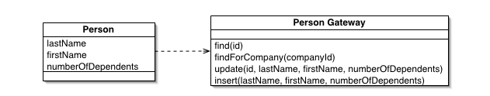
Enterprise Architecture Patterns : Mapping to Data Store
Table Data Gateway
  To each database table there is one Gateway Object
  Stateless
  Encapsulates database access
Row Data Gateway
  One variation of Table Data Gateway
Notes:
test

Slide 9
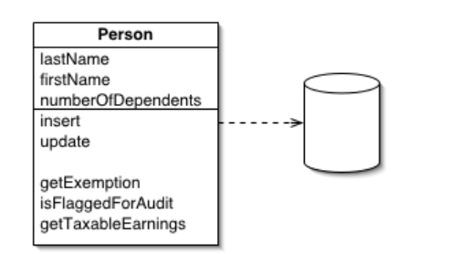
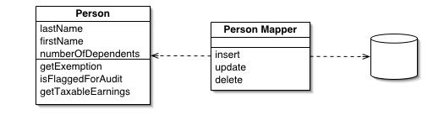
Enterprise Architecture Patterns : Mapping to Data Store
Active Record
  Maps to a row in a database table or view
  Encapsulates database access
  Includes domain logic
Data Mapper
  Layer of mapper between objects and database
  Makes object and database independent to each other
Notes:
test

Slide 10
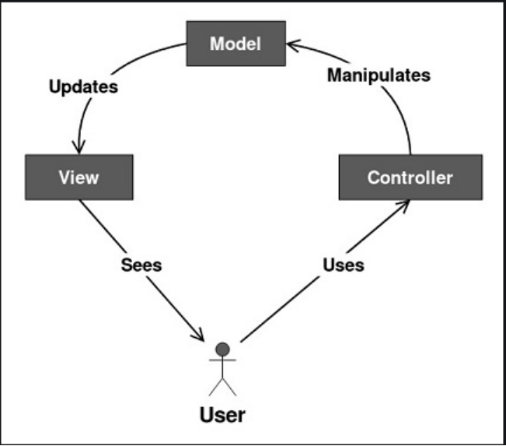
Enterprise Architecture Patterns : Presentation
Model View Controller (MVC) is THE most useful pattern for presentation
Most applications (frameworks also) today follow this pattern, many with slight variations
It suggests an application consist of a data model, presentation information, and control information.
Notes:
test

Slide 11
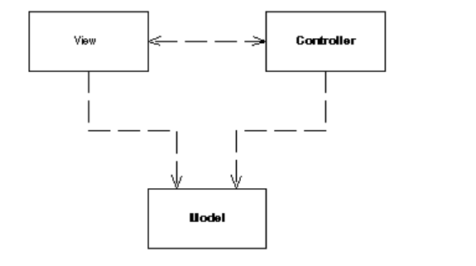
Enterprise Architecture Patterns : Presentation
Model contains only the pure application data; it contains no logic describing how to present the data to a user
View presents the model's data to the user.
  The view knows how to access the model's data, but it does not know what this data means or what the user can do to manipulate it.
Controller exists between the view and the model.
  It listens to events triggered by the view (or another external source) and executes the appropriate reaction to these events.
View and the model are connected through a notification mechanism
  The result of this action is then automatically reflected in the view.
Notes:
test

Slide 12
Enterprise Architecture Patterns : Concurrency
Optimistic Lock
  Does not allow other sessions to alter a record if it is altered by another session
  Implementation
    Version number
    Time stamps
Pessimistic Lock
  Record is exclusively locked by the session using it
    Write lock
    Read lock
    Read/Write lock
    Database feature
  Can create deadlock
Coarse-Grained Lock
Notes:
test

Slide 13
Enterprise Architecture Patterns : State
Client Session State
  Stores state on the client
    Session variable, cookies, hidden field etc.
Server Session State
  Keeps session state on a server in encrypted form
    Serialisation or similar
Database Session State
  Stores session data as committed data in database
Notes:
test

Slide 14
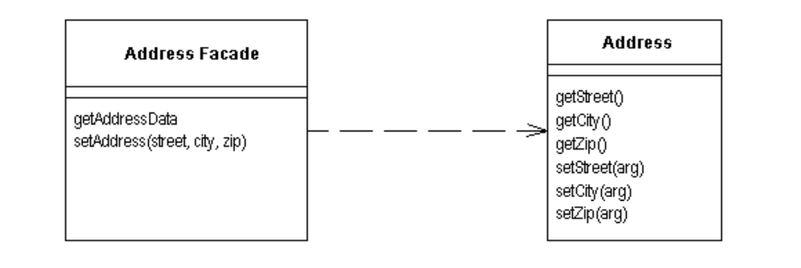
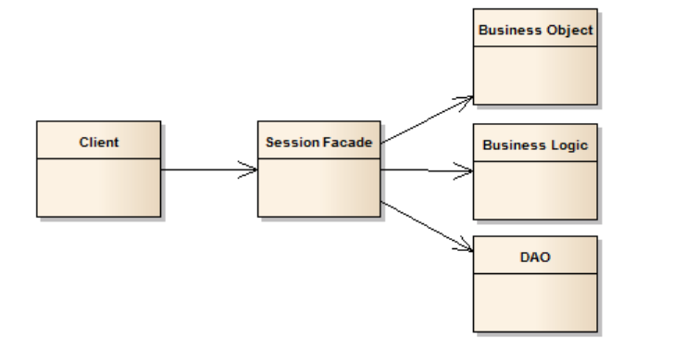
Enterprise Architecture Patterns : Distribution
How to Manage Interaction between Components in Different Tiers
Remote Facade
  A facade to improve efficiency over a network
  Does not have any logic
Session Facade
  Can include boundary logic
Notes:
test

Slide 15
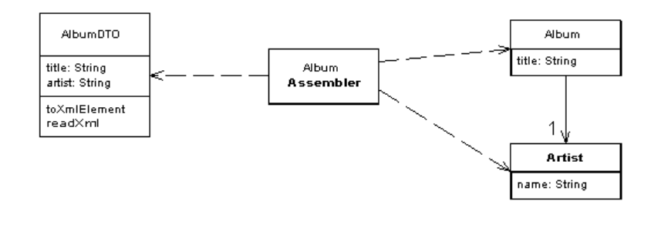
Enterprise Architecture Patterns : Distribution
How to Manage Interaction between Components in Different Tiers
Data Transfer Objects
  Used to transfer multiple attributes to reduce network traffic
  Serializable
  In server side an assembler is used to transfer data between DTO and Business Objects
  Aka 'Value Object'
Notes:
test

Slide 16
Enterprise Architecture Patterns : Integration Between Applications
File transfer
Data sharing
Remote procedure invocation
Messaging
Notes:
test

Slide 17
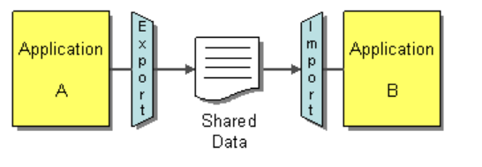
Enterprise Architecture Patterns : Integration Patterns: File Transfer
Each application produce files containing information
  At regular intervals according to the nature of the business
  Can be database dump as well
May need to transform files into different formats
  Aim to use standard format if possible
  Simple transformations can be done programmatically
  Need ETL tool for complex transformation
    Extract, transform, load
Notes:
test

Slide 18
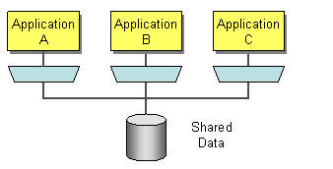
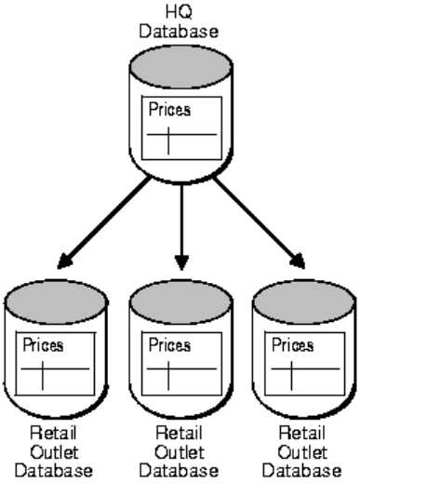
Enterprise Architecture Patterns : Integration Patterns: Data Sharing
Store application data in same database
Database replication also works
New application scenario
Notes:
test

Slide 19
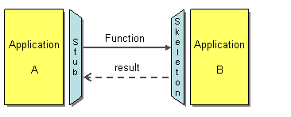
Enterprise Architecture Patterns : Integration Patterns: Remote Procedure Invocation
Each application is encapsulates data
Provide interface to allow other applications to interact
The style evolved
  RPC
  RMI
  Web Service
  SOA
  API
  Micro Service
Notes:
test

Slide 20
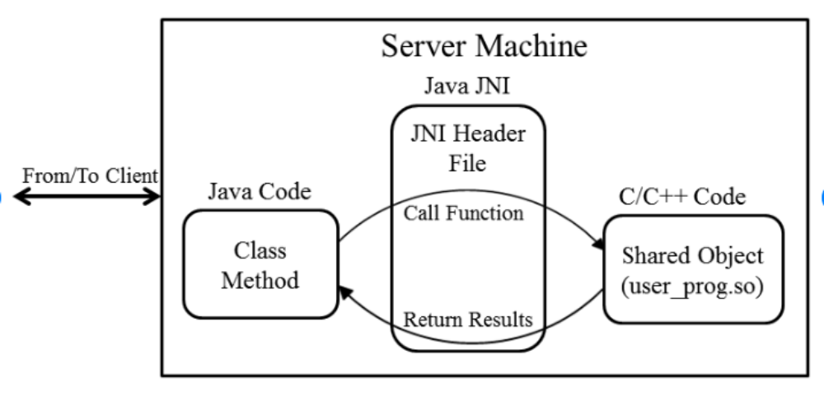
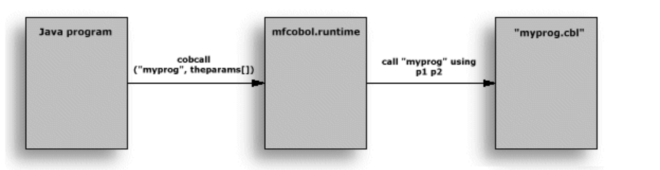
Enterprise Architecture Patterns : Integration Patterns: Legacy Integration*
Legacy application may not have contemporary way of connecting
  Provides C/C++ or COBOL functions
Native interface (e.g JNI) helps
*Rare situation now a days
Notes:
test

Slide 21
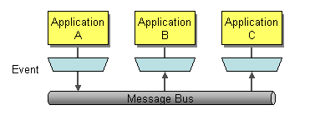
Enterprise Architecture Patterns : Integration Patterns: Messaging
Use Messaging to transfer packets of data using customizable formats
  Frequent
  Immediate
  reliable
  asynchronous
Notes:
test

Slide 22
Enterprise Architecture Patterns : Integration Patterns: Integration Tier
Data Access Object
Service Activator
Domain Store
Service Broker
Notes:
test

Slide 23
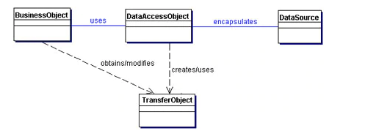
Enterprise Architecture Patterns : Integration Patterns: Data Access Object
Access to data varies with source data
Data Access Object abstracts and encapsulates all access to the data source
Notes:
test

Slide 24
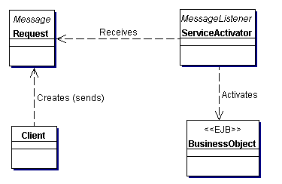
Enterprise Architecture Patterns : Integration Patterns: Service Activator
Business services need a way to be activated asynchronously
Service Activator receives asynchronous client requests
On receiving a request
  Service Activator locates and invokes the necessary business service
Notes:
test

Slide 25
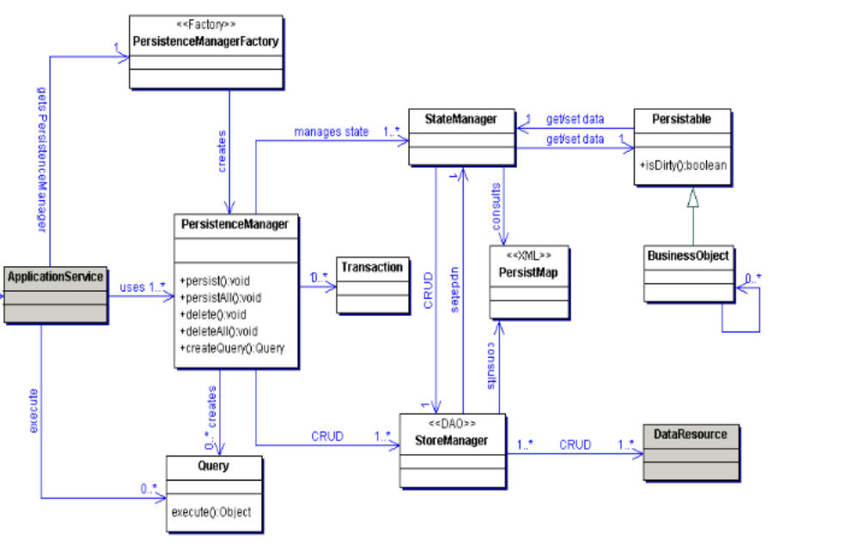
Enterprise Architecture Patterns : Integration Patterns: Domain Store
Separation of persistence from Business (Object Model)
Domain store transparently persist an Object Model
Notes:
test

Slide 26
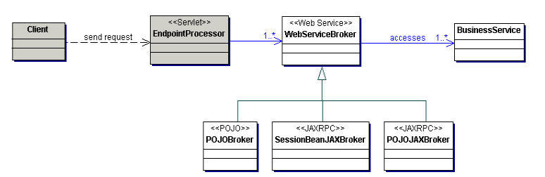
Enterprise Architecture Patterns : Integration Patterns: Service Broker
Provide access to one or more services using open protocols (e.g XML or JSON)
Service Broker exposes and brokers one or more services using open protocols
Example of Web Service Broker
Notes:
test

Slide 27
Enterprise Architecture Patterns : Reference
Patterns of Enterprise Application Architecture (The Addison-Wesley Signature Series) Hardcover – 5 Nov 2002 by Martin Fowler
Core J2EE Patterns: Best Practices and Design Strategies by Deepak Alur Chapter 8
https://www.enterpriseintegrationpatterns.com/patterns/messaging/toc.html
Notes:
test

